Slide 1


Master the Mainframe ft. DevSoc
An introduction to Mainframes and the Competition

Slide 2

MTM Checklist:
Register for the event here:
https://masterthemainframe.com/
Install Node.js (This will install NPM which you’ll need later on)
https://nodejs.org/en/
Install VS Code (You’ll need this to connect to IBM’s z15): https://code.visualstudio.com/download
Important VS Code Plugins:
Zowe Explorer
IBM Z Open Editor

Slide 3

What is MTM?
It’s an annual event run by IBM to help folks learn a new set of skills in relation to a relatively niche piece of technology.
Over the course of the event, you’ll refine your understanding of some languages (i.e. Python) while also picking up a few new ones such as COBOL, JCL, REXX to name a few.
Developing some level of familiarity with these languages and technologies will help you broaden your skill set as a developer …

Slide 4
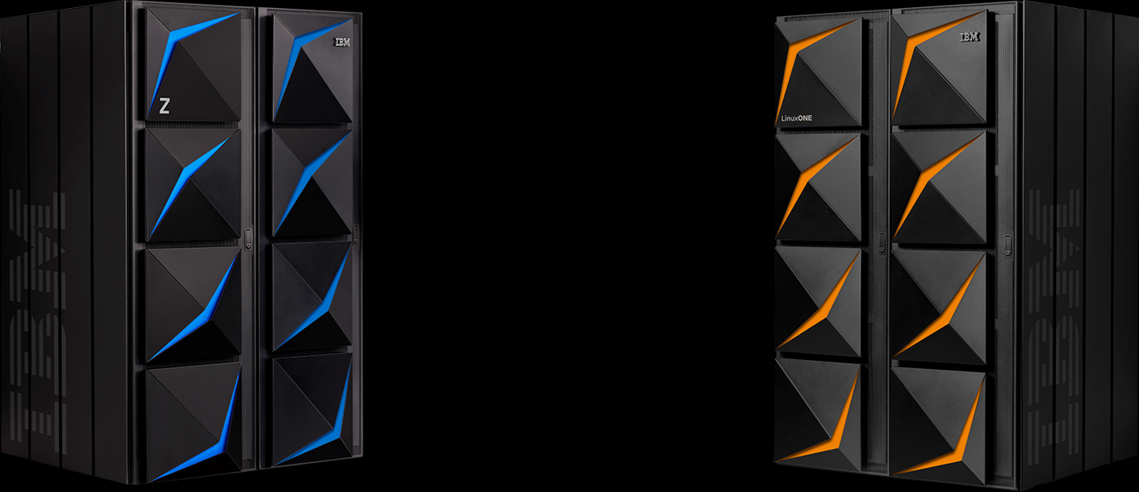
What is a Mainframe?
“ At their core, mainframes are high-performance computers with large amounts of memory and processors that process billions of simple calculations and transactions in real time.
The mainframe is critical to commercial databases, transaction servers, and applications that require high resiliency, security and agility. ”
- IBM
Notes:
As you progress along the exercises you’ll soon learn about this but essentially, as you complete each challenge you’ll be using one of these mainframes. You’ll sort of have a “section” of it all to yourself to fiddle with. Though, try your best not to break it like some of us did when they first launched the event.

Slide 5

LEVEL ONE:
You’ll first learn a little bit more about the mainframes, how they work and of how they’ll be used in this event. You’ll then be given your credentials to access your allocated section of the z15.
We’ll be walking folks through getting yourself all set up and logged in once everyone reaches Level 1.2
Prizes:
Feed 2 Children for a Day
For every Level One finisher, a donation will be made to ShareTheMeal

Slide 6

LEVEL 1.2 - SETUP TUTORIAL
Notes:
Get ready to following along with one of our instructors ...

Slide 7

LEVEL TWO:
It’s time to start actually working on some of the challenges. Each challenge in this stage is accompanied by a step-by-step guide to help you grasp the new concepts while you experiment.
We’ll be here to support you as you progress through each challenge… if you’re stuck send a quick SOS to chat and we’ll help you out.
Prizes:
Industry Recognized Digital Badge: Earn the Level Two IBM Master the Mainframe badge certifying your skills
Finishers entered into a drawing for a chance to win one of 45 $500 e-gift cards
Notes:
We won’t be doing any walkthroughs as we want to encourage you to do your own research as that’s a necessary skill you’ll need to hone to be able to attempt the final level of challenges. Independent learning is key here!

Slide 8
LEVEL 2 - SUPPORT SESSION
Notes:
Get ready to work on some challenges ...

Slide 9

LEVEL THREE:
At this stage, you’re expected to use everything you’ve learnt in the previous level to solve these new challenges. A lot of them will require some time spent searching through documentation and doing a little bit of research on a programming language/technology.
Prizes:
Limited edition 2020 IBM Master the Mainframe T-Shirt & an industry-recognized Level Three IBM Master the Mainframe badge.
Top 2 Individuals from each Region: $2500 travel stipend to visit an IBM event in your region and meet with key executives and employers.
Top 3 Individuals Globally: $1,000 USD education scholarship.

Slide 10
Resources:
https://masterthemainframe.com/
https://www.ibm.com/it-infrastructure/z/education/master-the-mainframe
https://www.ibm.com/it-infrastructure/servers/mainframes
https://www.ibm.com/uk-en/products/z15/details
https://jlelliotton.blogspot.com/2019/09/ibm-z15-and-ibm-linuxone-iii-announced.html?m=0
Notes:
Some resources we used to make this presentation

